Slide 1


For Beginner
By :- RAHUL JOGRANA
www.dotnetlab.in
www.aspnetinhindi.blogspot.com
Twitter:- @thejograna
Github:- github.com/rahuljograna
Part 13 segments in ionic

Slide 2


Segments in ionic
Segment is a collection of buttons that are displayed in line. They can act as a filter, showing/hiding elements based on the segments value.

Slide 3
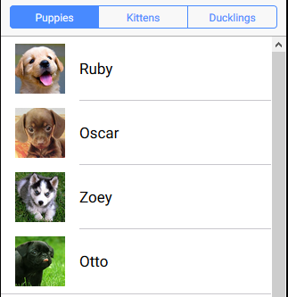
Inputs in ionic

Slide 4
Let’s start

Slide 5
To learn new Technology along with Example like
ASP.NET, ASP.NET MVC, AngularJS, ASP.NET Web API
From Beginners visit my Youtube channel and steps and Source code is
Available on My Blog and Web site
To Get notification for new updates Subscribe my YOUTUBE Channel.
Source Code :- http://aspnetinhindi.blogspot.com
Website :- http://www.dotnetlab.in
Github :- https://github.com/rahuljograna
Twitter :- twitter.com/thejograna
Mail :- rahuljograna007@gmail.com
WhatsApp Number :- 9426585554

Slide 6
To Develop Application
Contact me
Mail me : rahuljograna007@gmail.com
Mobile : +91 9426585554
whatsApp : +91 9426585554

